Slide 1
Control Flow
Rajasekaran S
Assistant Professor,
Department of Information Technology,
KGiSL Institute of Technology,
email: proffraja@gmail.com
Github:www.github.com/rajasekaranap

Slide 2
Control Flow Statements
control flow (or flow of control) is the order in which individual statements, instructions or function calls of an imperative program are executed or evaluated.
Control flow statements, however, break up the flow of execution by employing decision making, looping, and branching, enabling your program to conditionally execute particular blocks of code.

Slide 3
Types Control Flow Statements
Control Flow
Decision Making
Looping
Unconditional Jumps
If - else
for
break
If – elseif - else
while
do-while
continue
switch
for-each

Slide 4
Decision Making
It is used to make decision based on the condition.
It contains two block of codes
if block
else block
If requires Boolean condition [True or False].
If condition passed if block is executed otherwise else block is execued.

Slide 5
Syntax
if (boolean_condition){
//block of code
}
else{
//block of code
}

Slide 6
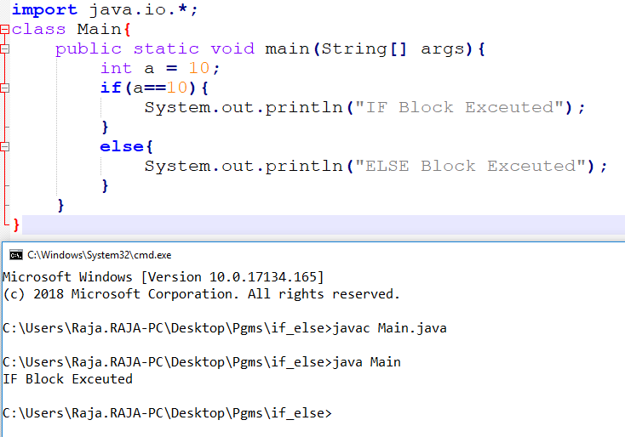
if Block

Slide 7
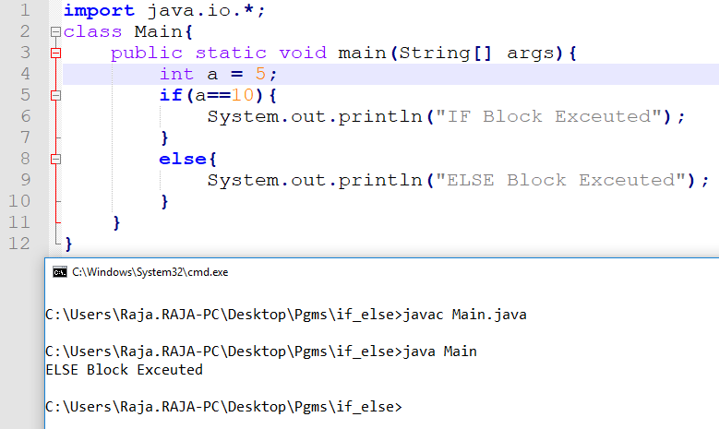
else Block

Slide 8
if – elseif - else
if (boolean_condition){
//block of code
}
else if(boolean_condition2){
//block of code
}
else{
//block of code
}

Slide 9
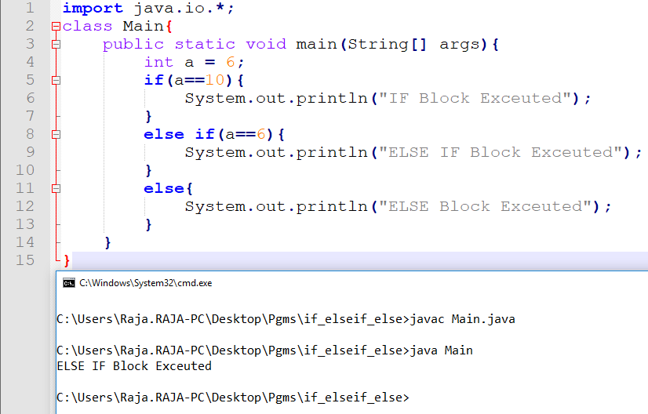
if – elseif - else

Slide 10
Problems
Finding given number is ODD or EVEN.
Greet a person with gender identification.
Finding given number is positive or negative.

Slide 11
Nested IF
The if else contains if else statement is know as nested if else.
if (boolean_condition 1){
//block of code
if(boolean_condition 1.a){
//Inner if block
}
else{
//Inner else block
}
}
else{
//block of code
}

Slide 12
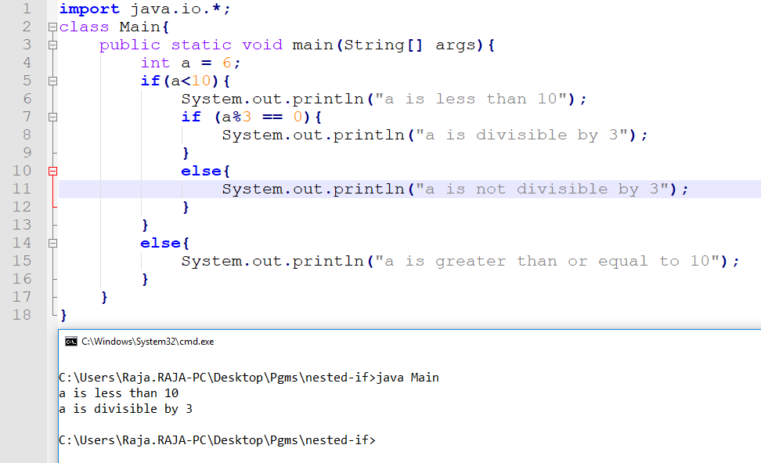
Example [a<10 and div by 3]

Slide 13
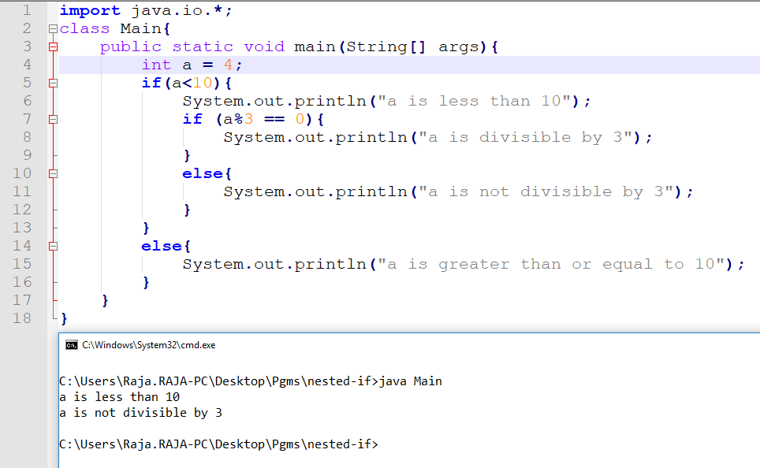
Example [a<10 not div by 3]

Slide 14
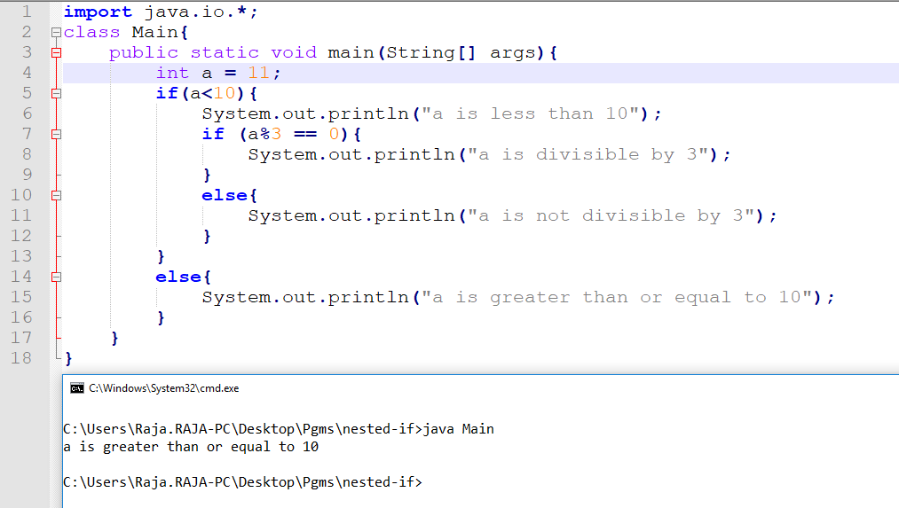
Example [a is not less than 10]

Slide 15
Switch
Matched
Case 1
Statement 1
Break
Unmatched
Matched
Case 2
Statement 2
Break
Unmatched
Matched
Default
Statement default
Break

Slide 16
Syntax
switch(expression) {
case value :
// Statements
break;
case value :
// Statements
break;
default :
//Statements
break;
}

Slide 17
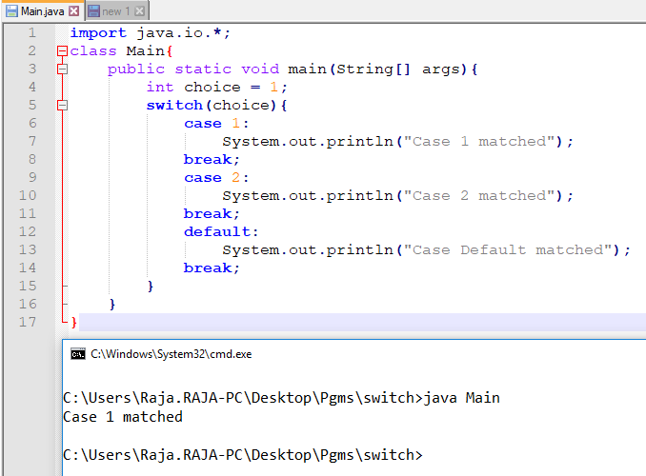
Example [Case 1]

Slide 18
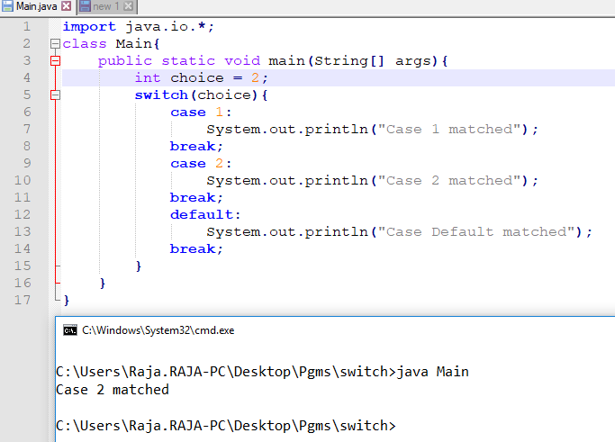
Example [Case 2]

Slide 19
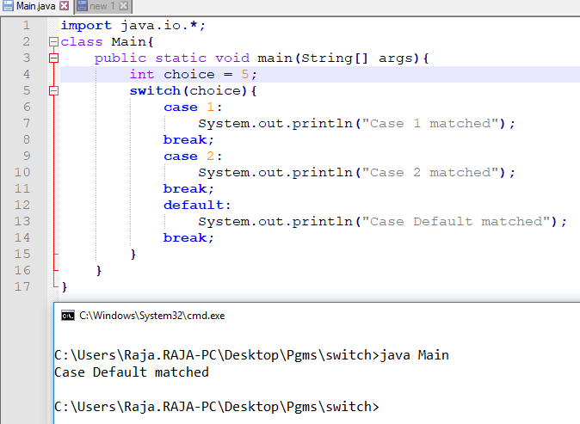
Example [Case Default]

Slide 20
Problem
Create Simple Calculator that gets inputs from user and get the choice of operation and display the results accordingly.

Slide 21
Thank You
Rajasekaran S
Assistant Professor,
Department of Information Technology,
KGiSL Institute of Technology,
email: proffraja@gmail.com
Github:www.github.com/rajasekaranap

